Slide 1
KYC
Revolut HomeTask - 1

Slide 2
INCENTIVE
The aim is to determine the root causes of substantial decline of ‘pass rate’ in the recent period and offer an optimal solution for it.

Slide 3
INITIALISATION
To determine the cause of an unusual behaviour we need to analyze the dataset. There are following issues in the data in its current format -
Data is not sorted by date.
Date and time is in single column which is leading to difficulty in analysis.
All the elements in properties column are dictionaries which is difficult to interpret.
Our first step is data preprocessing to simplify the data for easy observation and manipulation.

Slide 4
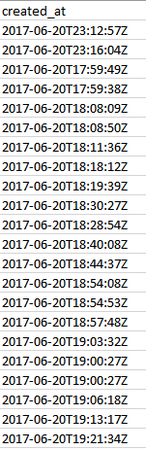
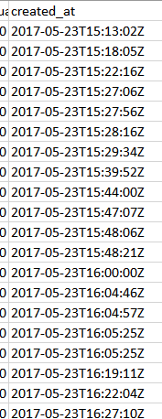
DATA PREPROCESSING
Sorting the rows of the sheet by date in ascending order.
Previous
Now

Slide 5
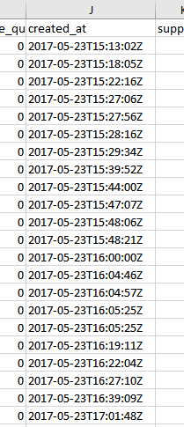
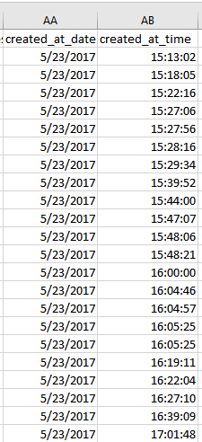
DATA PREPROCESSING
Date Time Split
2017-05-23T15:13:02Z
[2017-05-23, 15:13:02 ]

Slide 6
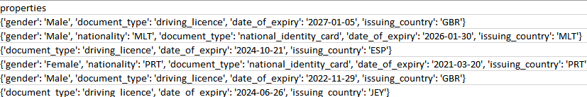
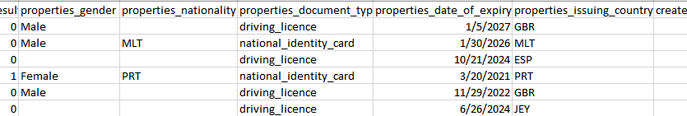
DATA PREPROCESSING
Splitting Properties

Slide 7
FINDING UNUSUAL BEHAVIOUR
Since we know that the ‘pass rate’ has been substantially decreased, there must be some unusual trends in the data which needs to be revealed so that we could get some clues regarding the cause of such behaviour.
The first step is to plot the trend of the column ‘result’ with ‘time’ in the excel sheet doc_report.csv.

Slide 8
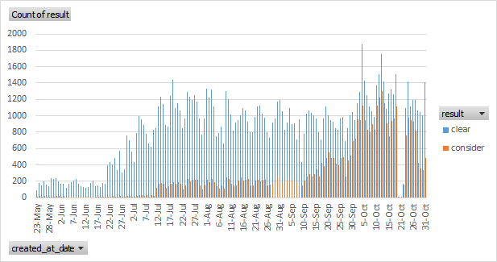
RESULT VS TIME

Slide 9
RESULT VS TIME
From the graph we can observe two unusual trends in ‘considerable results’ relative to ‘clear results’.
Sudden increase in considerable results from 10-July
Unexpected rise in the month of october
So now, it can be verified from the plot that the ‘pass rate’ has significantly decreased with time recently.
Now, since trend in overall result has been analyzed, we have to proceed further to visualize the trend in different category of results with time to check which categories are actually affecting the result.
After visualizing each category of results, unusual behaviour in some of them were observed which are shown from the next slide.

Slide 10
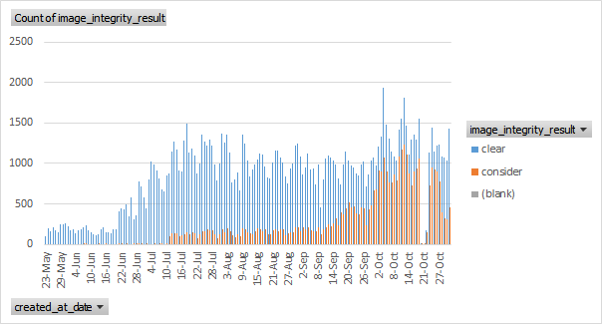
IMAGE INTEGRITY RESULT VS TIME

Slide 11
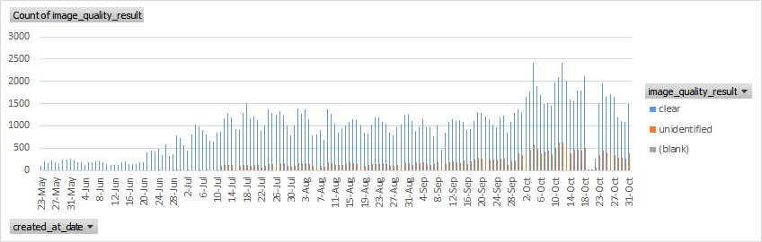
IMAGE QUALITY RESULT VS TIME

Slide 12
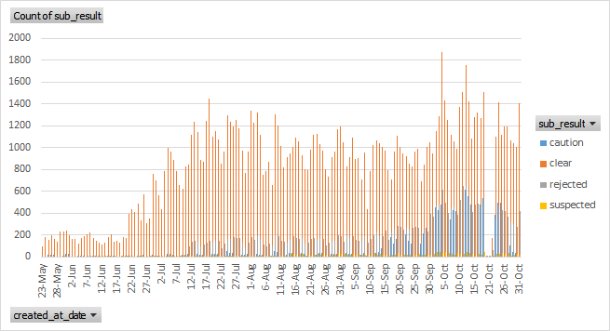
SUB RESULT VS TIME

Slide 13
ANALYSIS
The root cause has affected the image integrity, image quality and sub results in the same way as it has affected the overall result.

Slide 14
THE SECOND TREND

Slide 15
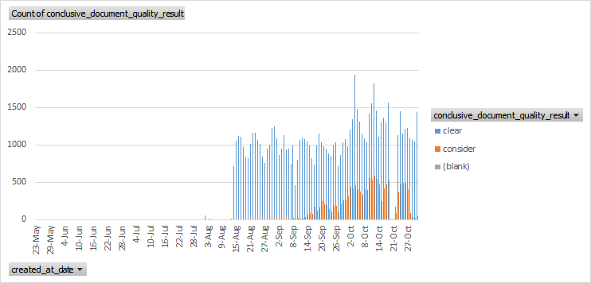
CONCLUSIVE DOCUMENT QUALITY RESULT VS TIME

Slide 16
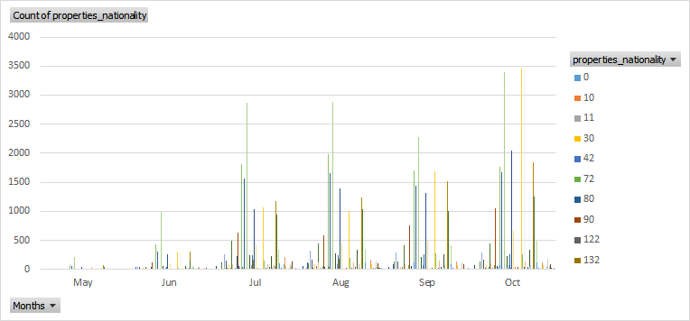
PROPERTIES NATIONALITY VS TIME

Slide 17
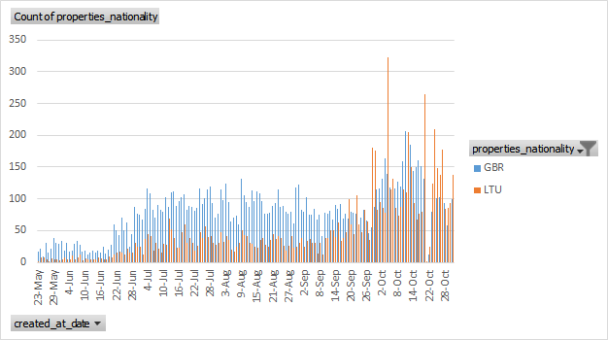
NATIONALITY (GBR & LTU) VS TIME

Slide 18
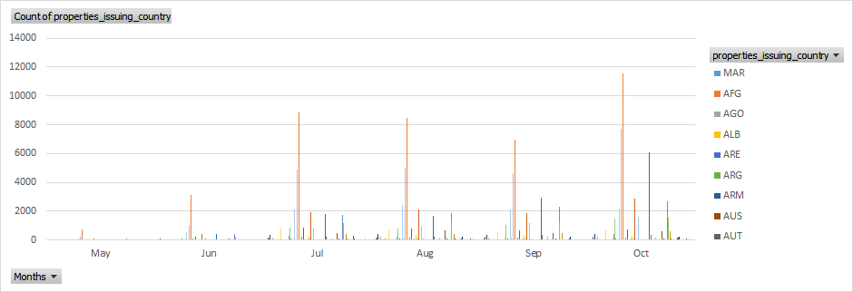
ISSUING COUNTRY VS TIME

Slide 19
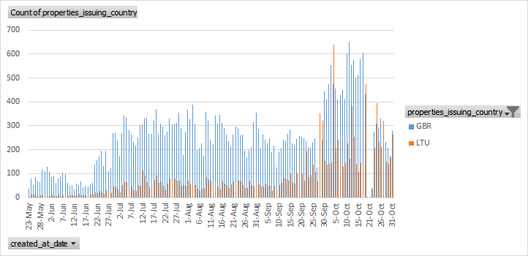
ISSUING COUNTRY (GBR & LTU) VS TIME

Slide 20
ANALYSIS
As we know that there were two unusual trends observed in the result out of which one trend was the significant rise in the month of october. This trend has been observed in the past slides shown. From those slides following points can be concluded -
Conclusive document quality test has been very active since middle of the august. This test has shown significant rise in ‘considerable’ results in the month of october which could be the primary cause of the second trend of the overall result.
In both ‘Issuing country’ and ‘Properties nationality’ GBR and LTU were the only countries showing the trends equivalent to the second trend of the overall result.

Slide 21
ANALYSIS
These two conclusions lead to the fact that ‘GBR’ and ‘LTU’ is failing in the ‘Conclusive document quality’ test which then leads to non-clear ‘image integrity result’.
We have to verify this phenomenon by plotting and analyzing the trend between two countries and their Conclusive document quality results. This plot is shown in the next two slides.

Slide 22
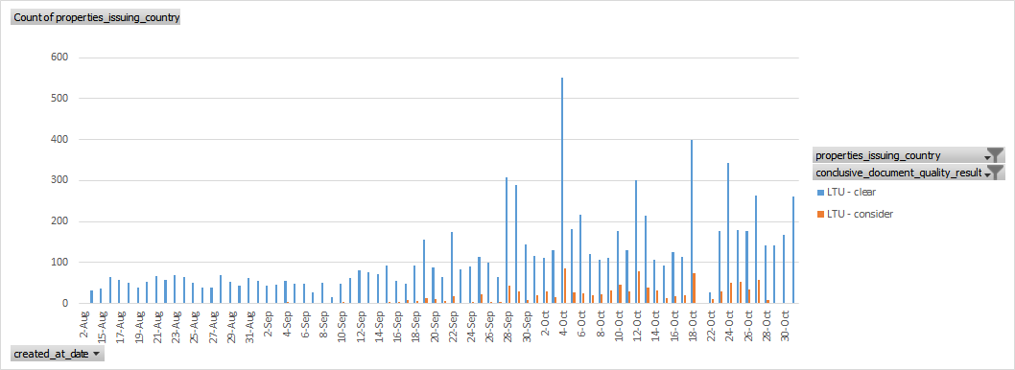
CONCLUSIVE DOCUMENT RESULT OF LTU VS TIME

Slide 23
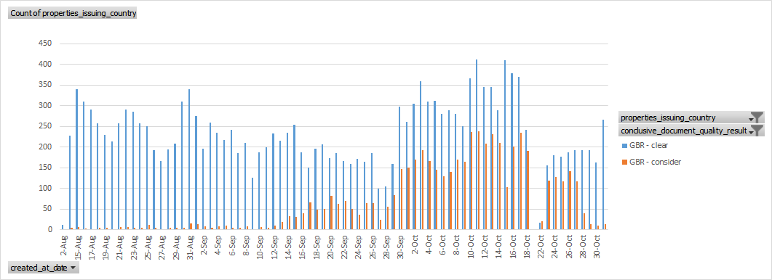
CONCLUSIVE DOCUMENT RESULT OF GBR VS TIME

Slide 24
ANALYSIS
The expected trend was very strongly observed in GBR than ‘LTU’. Hence, now we know that the second trend in the overall result was due to the ‘document quality’ issue observed in GBR which also affected the ‘image quality’, ‘image integrity’ and Sub results in them. Now all the documents used by GBR were analyzed in which some showed the expected trend. Those are plotted in the next two slides.

Slide 25
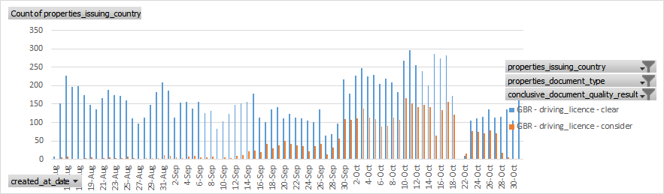
GBR DRIVING LICENCE QUALITY RESULT VS TIME

Slide 26
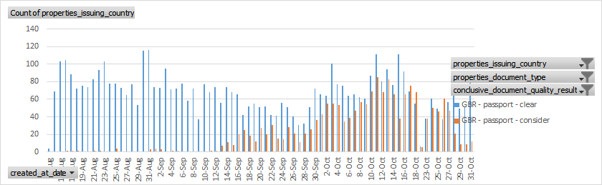
GBR PASSPORT QUALITY RESULT VS TIME

Slide 27
SOLUTION
Since we saw that GBR is responsible for the recent decrease in pass rate who are using two main documents i.e. driving licence and passport. And those two documents have are suspected to have non-clear image quality. Therefore, it is suggested that the KYC applied by people in GBR should get their documents strictly verified, either manually or by a secure way.

Slide 28
THE FIRST TREND

Slide 29
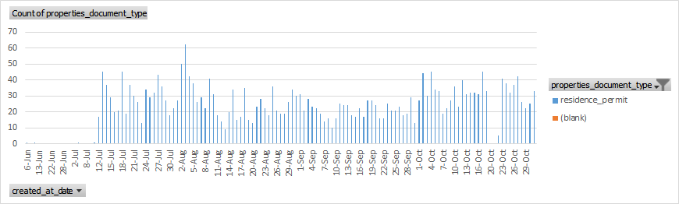
DOCUMENT TYPE VS TIME

Slide 30
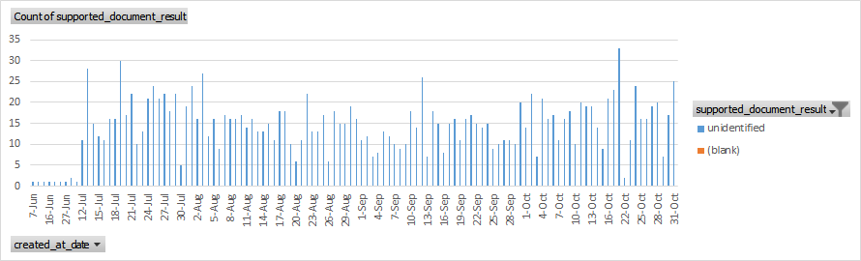
SUPPORTED DOCUMENT RESULT VS TIME

Slide 31
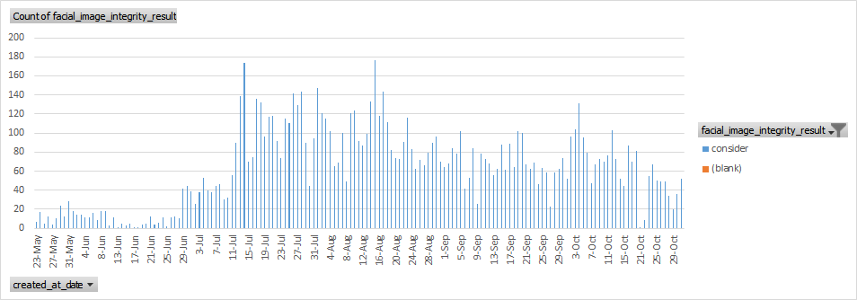
FACIAL IMAGE INTEGRITY RESULT VS TIME

Slide 32
ANALYSIS
Here, we can can observe the first unusual trend of the overall result which is the abrupt increase in considerable cases since 10 July. We can now say that ‘residence permit’ and ‘supported document result’ are the key factors of the abrupt change.
Now, it is required that we see the countries which used ‘residence permit’ as their document and analyse them.

Slide 33
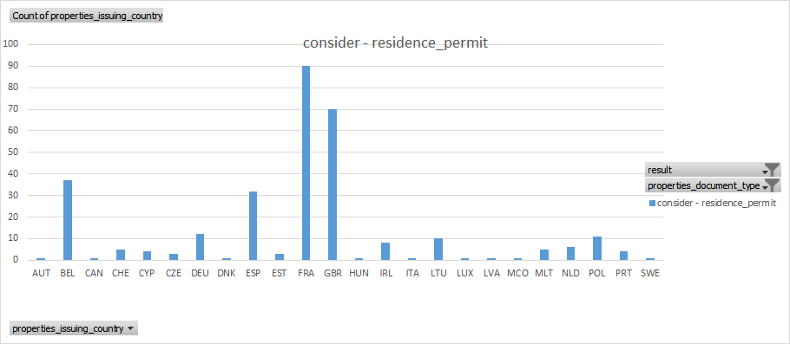
RESIDENCE PERMIT RESULT VS ISSUING COUNTRY

Slide 34
ANALYSIS
From the graph, we can observe that the residence permit was used primarily in two countries i.e.GBR and FRA. Also, we have seen how GBR was responsible for second trend in the overall result. This makes our prediction more stronger.
Now it plausible to plot the trend of these two countries using ‘residence permit’ as document. This has been done in the next two slices.

Slide 35
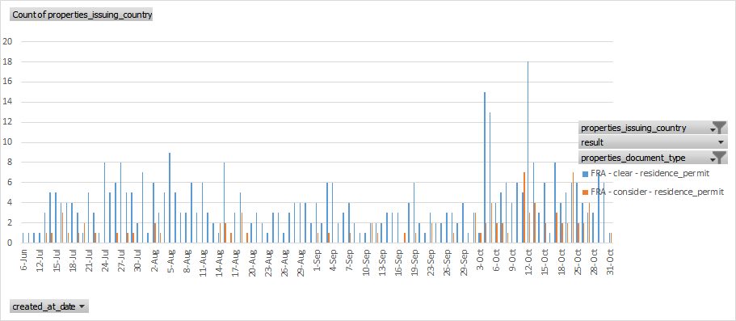
FRA RESIDENCE PERMIT RESULT VS TIME

Slide 36
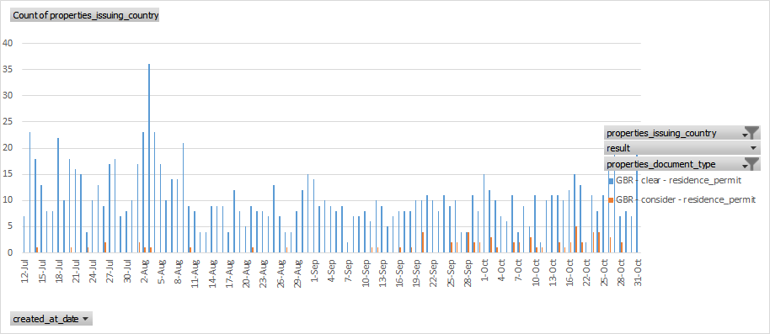
GBR RESIDENCE PERMIT RESULT VS TIME

Slide 37
ANALYSIS
Therefore, from these trends we can conclude that GBR and FRA people who use ‘residence permit’ as the document have considerably unclear facial image integrity which is creating the first trend in the overall result of the KYC process.

Slide 38
SOLUTION
Therefore, it is advised that KYC applied using ‘residence permit’ should be strictly checked for image integrity either manually or with state-of-the-art ways especially by people from GBR and FRA to avoid any further issues.

Slide 39
THANK YOU

